Slide 1
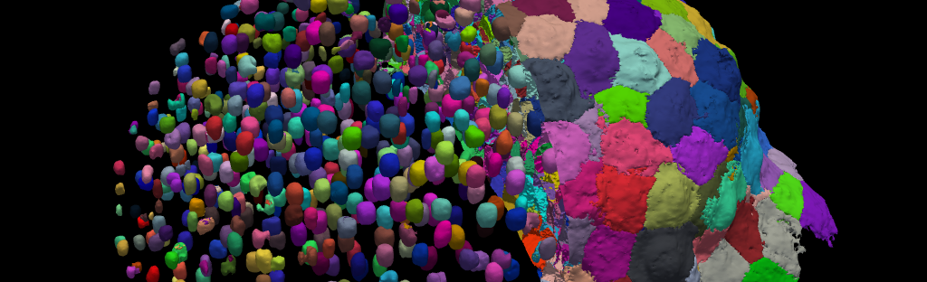
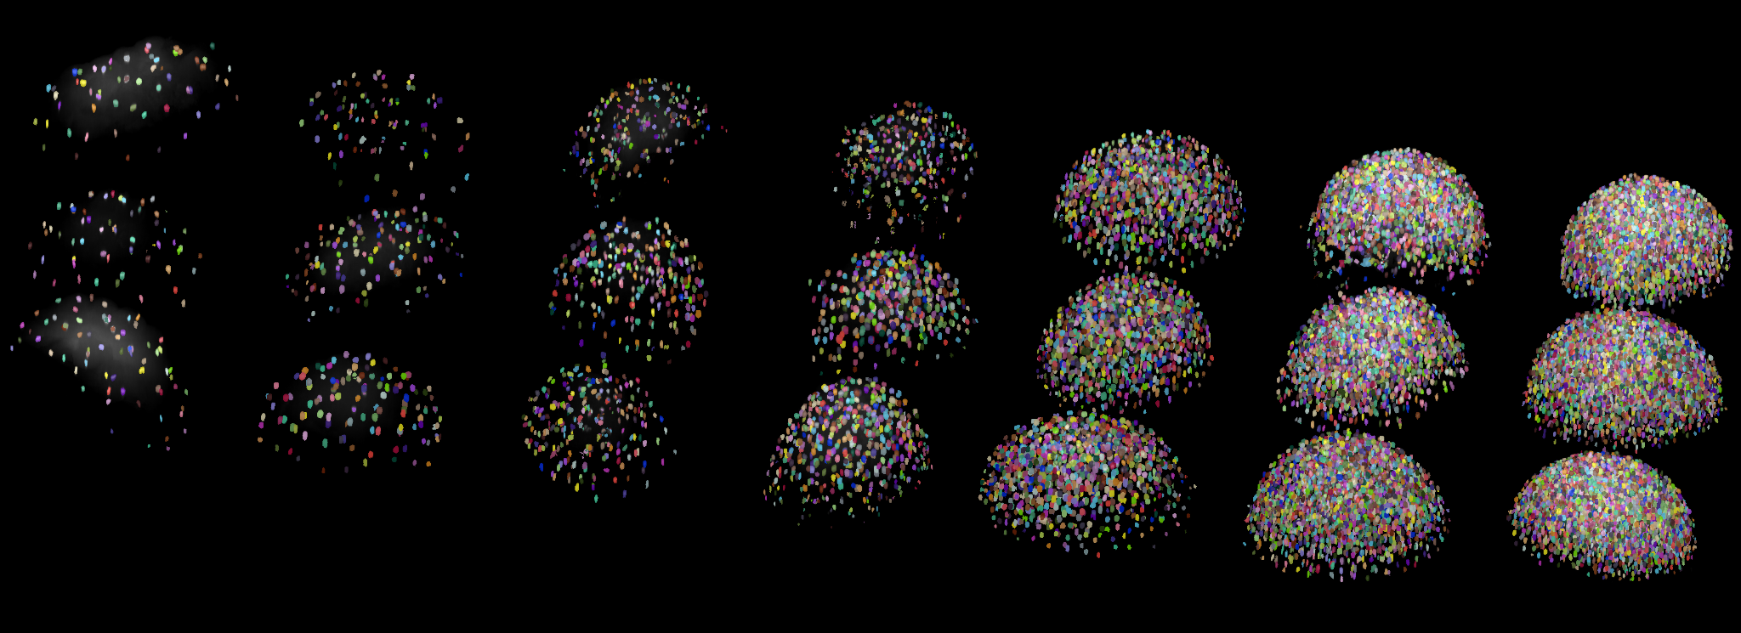
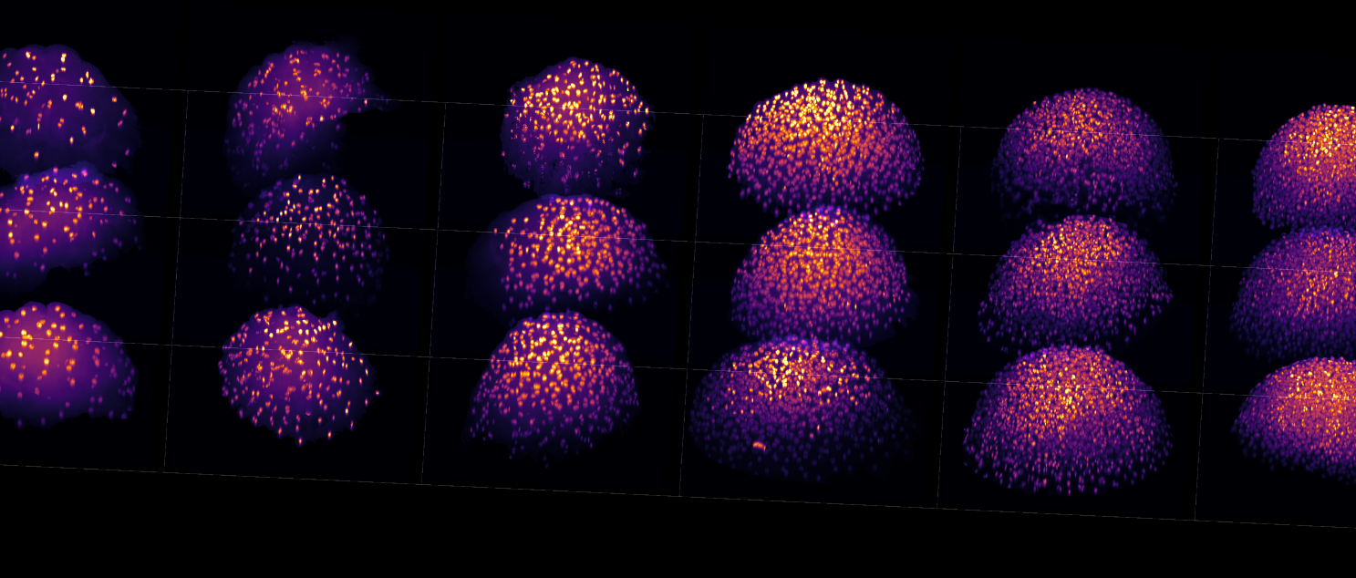
Systems dynamics in cell and developmental biology
IT introduction

Slide 2
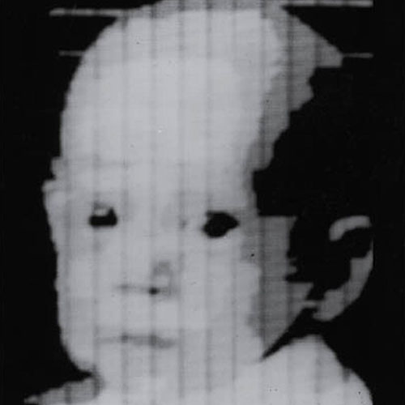
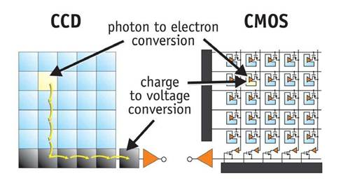
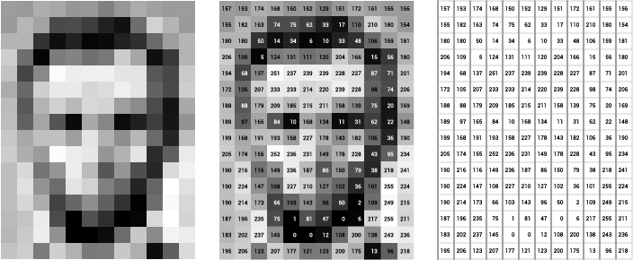
What is a digital image?
Digital images of real objects are generated by light-sensitive sensors (e.g. CCD or CMOS)
These sensors are made of small units (pixels) arranged in a grid.
For each pixel, the incident light is converted into an intensity value.
The bit-depth of an image defines how many different values a pixel can have
E.g. 8-bit image: 256 (2⁸) different gray values (0-255)
First digital image (Russel Kirsch, 1957)
Working principle of CCD and CMOS sensors (https://meroli.web.cern.ch/lecture_cmos_vs_ccd_pixel_sensor.html)
Matrix representation of a grayscale image (https://ai.stanford.edu/~syyeung/cvweb/tutorial1.html)

Slide 3
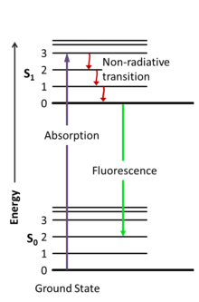
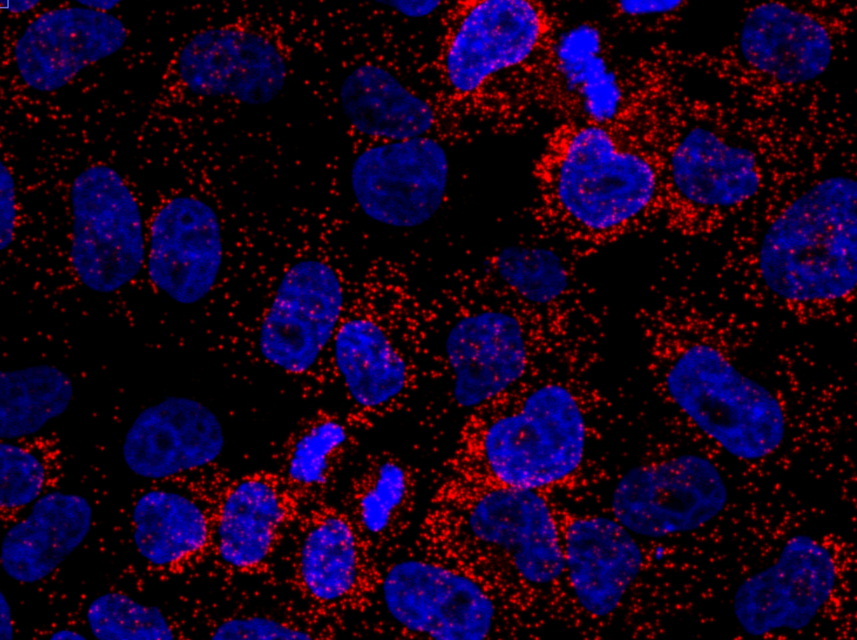
Images in fluorescence microscopy
In fluorescence microscopy, images are generated in the same way just explained
Fluorescent probes can be excited with a specific wavelength of light and will emit light of a longer wavelength
The emitted light is then captured by a camera that turns it into a digital image
We call these types of images «intensity images», as opposed to other types of digital images

Slide 4
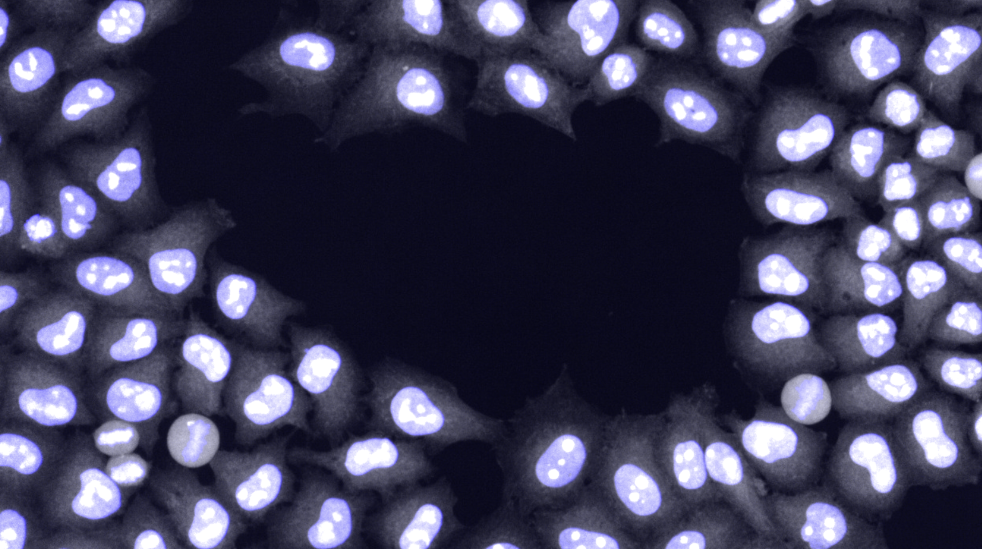
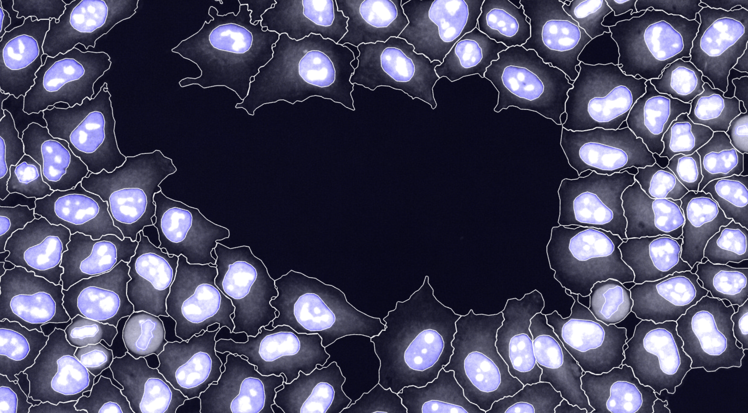
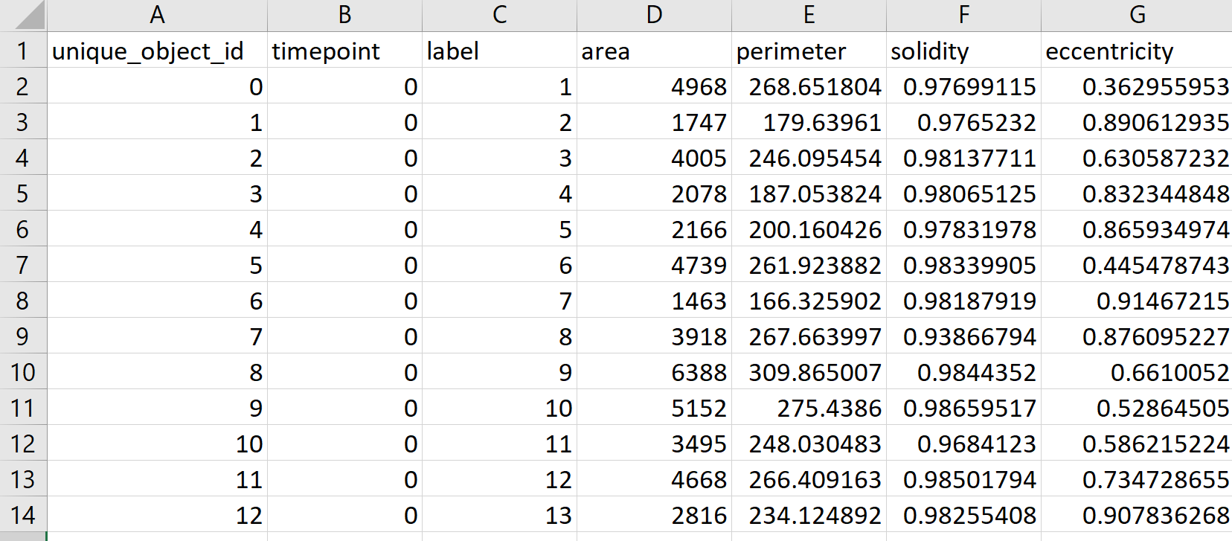
Image-based systems biology approach
The goal is to extract information from images
Typically, we are interested in measuring features of distinct objects in the image. For example:
Cells
Nuclei
Embryos
The first step in biological image analyis often is to identify where in the image our objects of interests are.
This process is called image segmentation

Slide 5
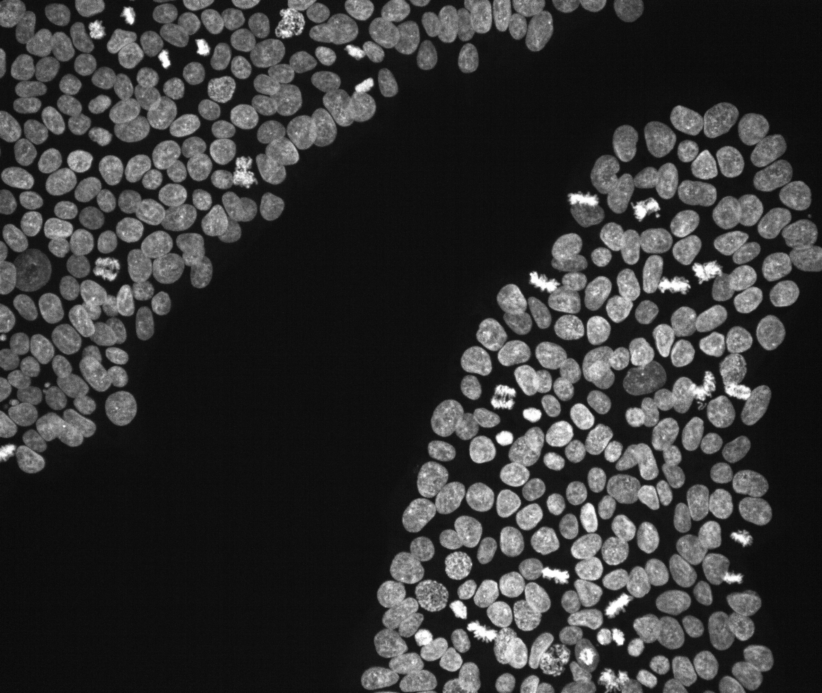


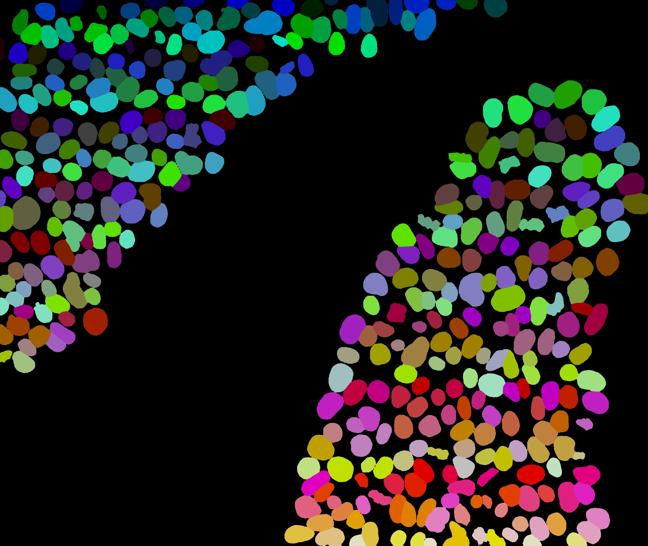
Image segmentation
The output of image segmentation typically is a «label image»
Background pixels of a label image usually have the value 0
All pixels assigned to a distinct object have the same value
Basic measurements can directly be extracted from label images with the help of image-processing libraries
Typical measurements could be:
Area of the object (in pixels)
Roundness of the object
Mean intensity of all pixels of an intensity image contained in the object

Slide 6
Data exploration and plotting
IT introduction

Slide 7
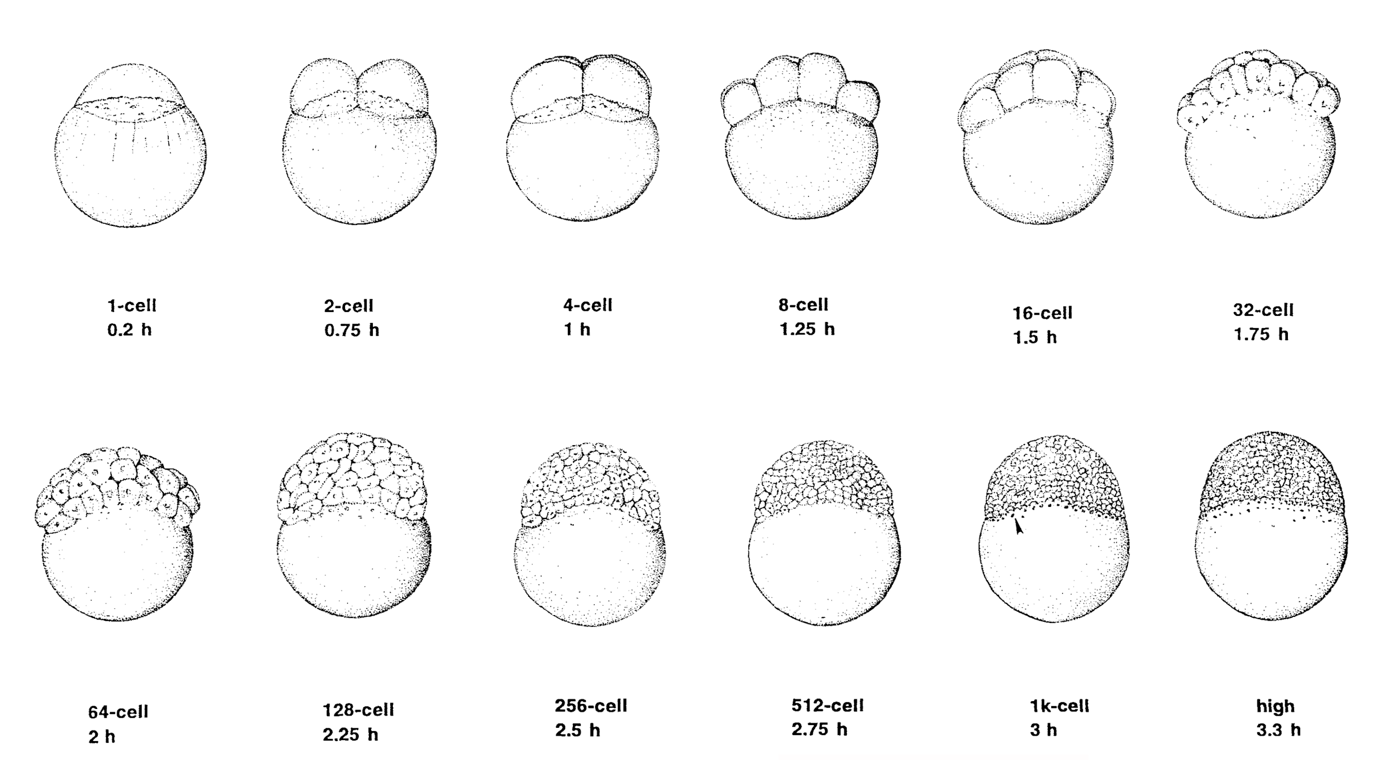
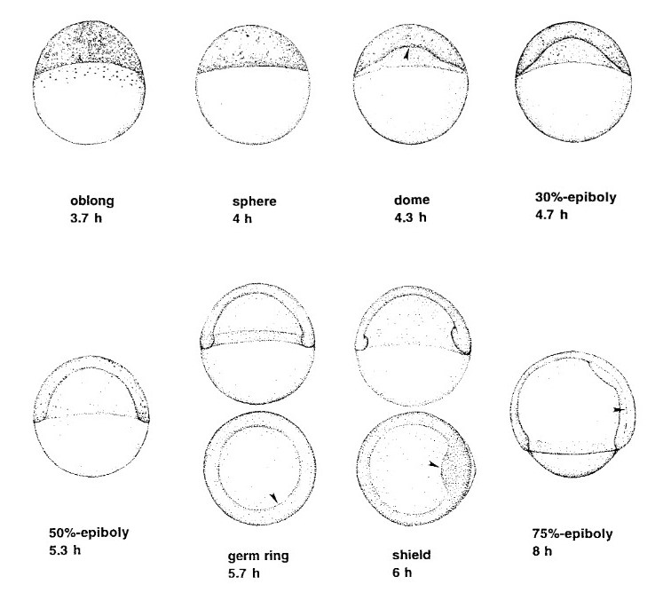
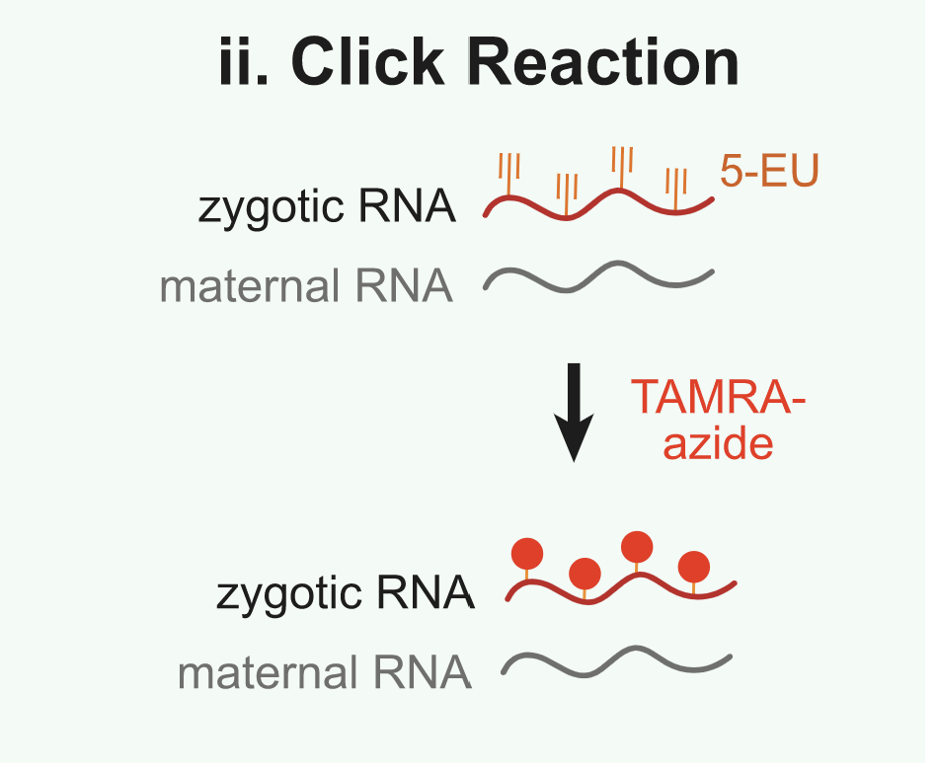
5-EU injection in zebrafish embryos
ZGA
Zygote
Cleavage
Blastula
Kimmel et al. 1995
1
2
3
4
5
t [hpf]
Injection
fixation 2-4 hpf based on time point of laying
~10 embryos per time point
Chen et al. 2019

Slide 8
Click-it and IF staining
Pool embryos across timepoints in an Eppi
Click-it staining with AF647-azide
IF against β-Catenin (568) and PCNA (405)
SYTOX-488 to stain DNA
2 replicates

Slide 9
Installation of basic components for BIO325
IT introduction

Slide 10
Installation of basic components for BIO325
https://github.com/adrtsc/bio325_2022
Follow the Read Me instructions

Slide 11

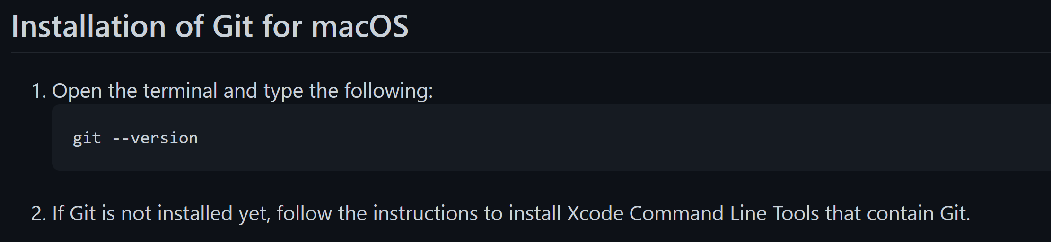
Installation of Git
Windows
macOS
http://git-scm.com/downloads

Slide 12
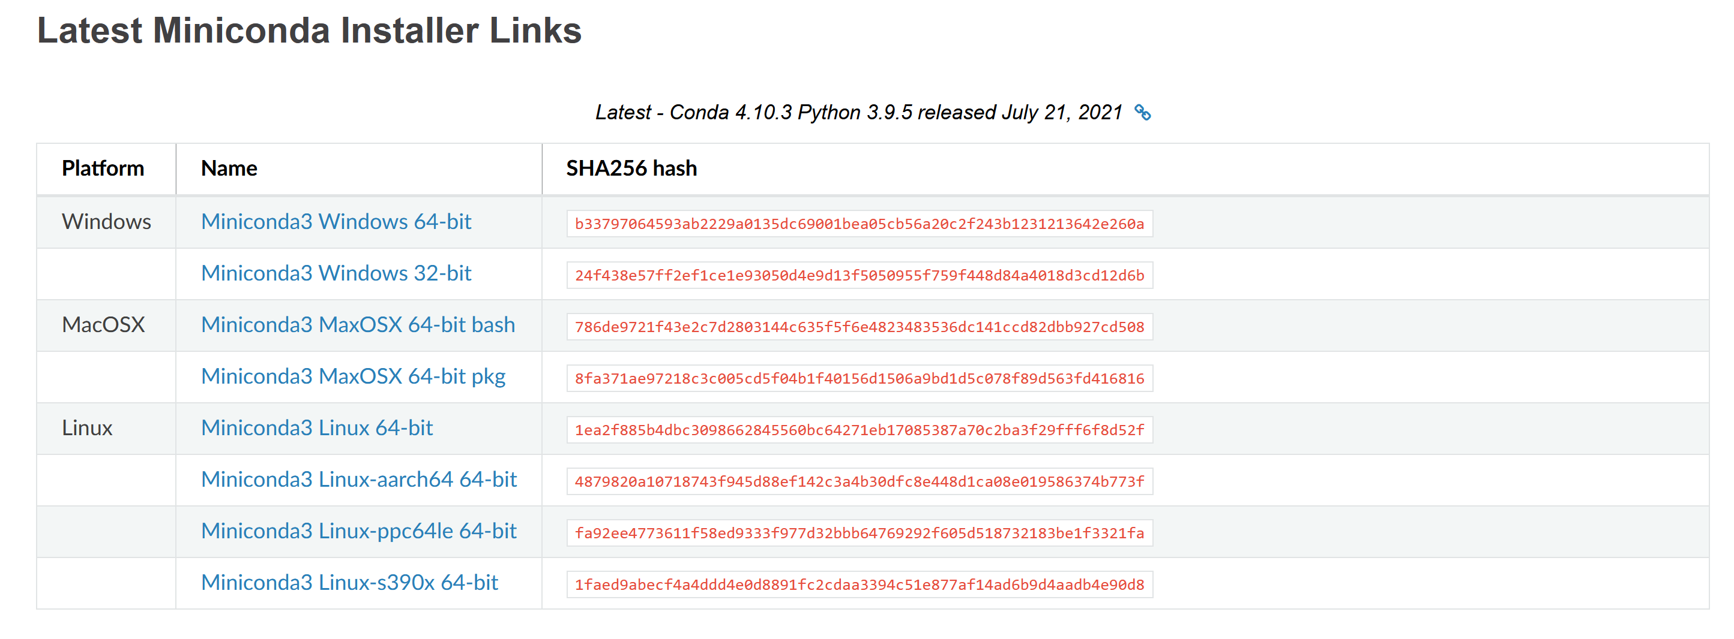
Installation of Miniconda
https://docs.conda.io/en/latest/miniconda.html

Slide 13
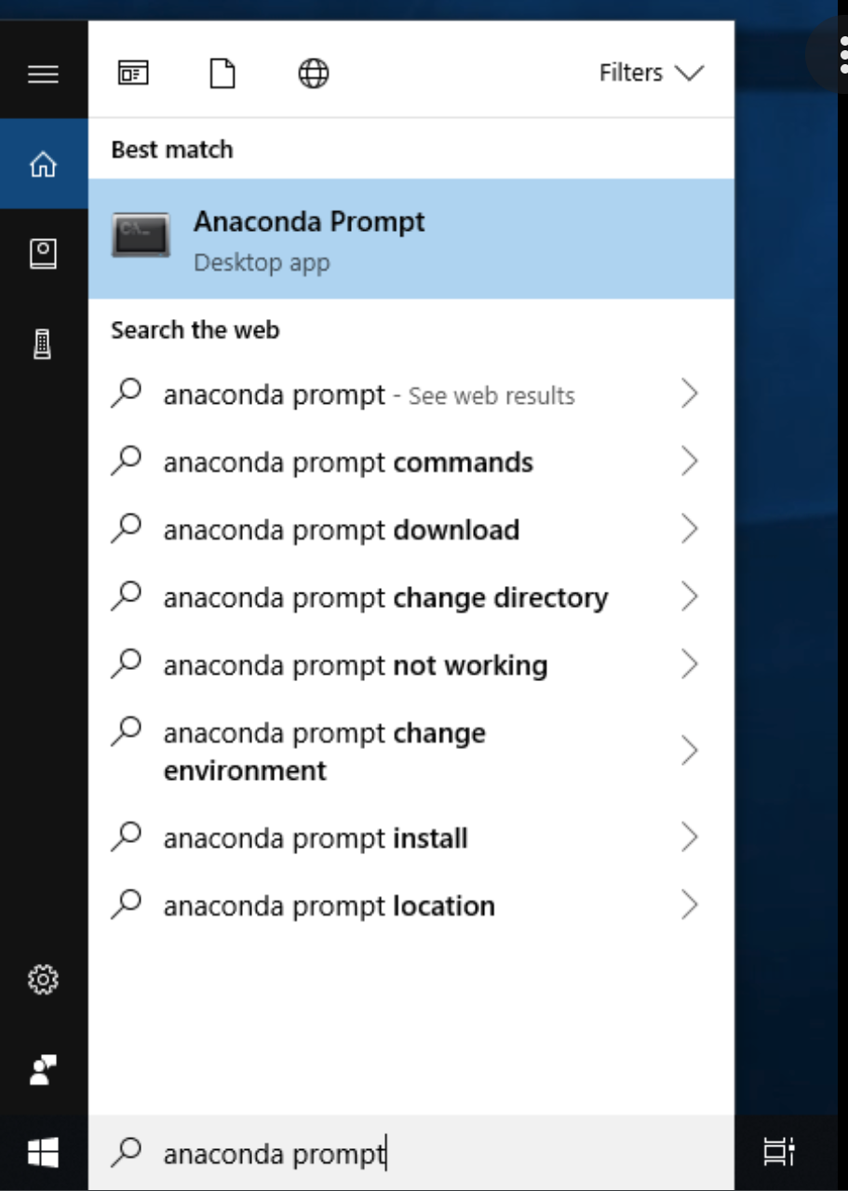
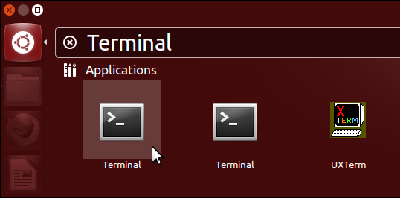
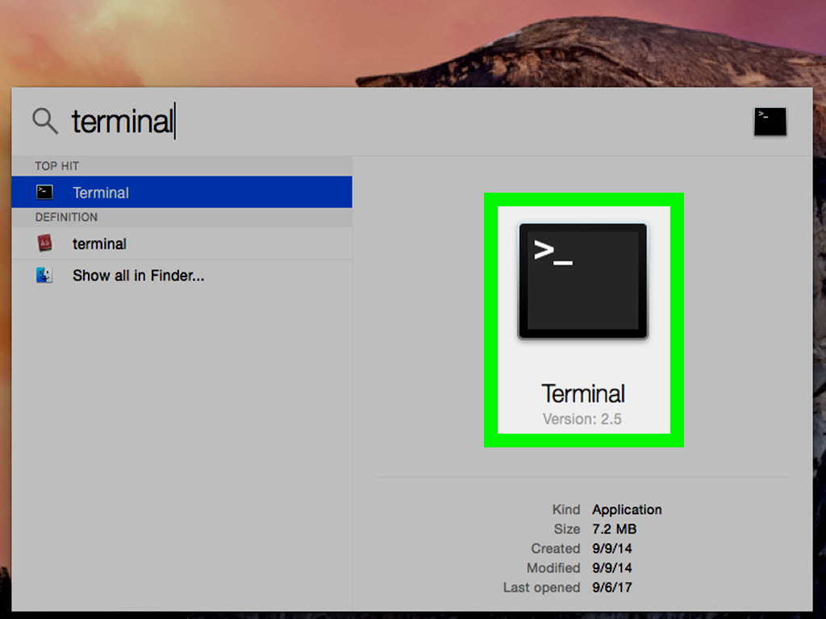
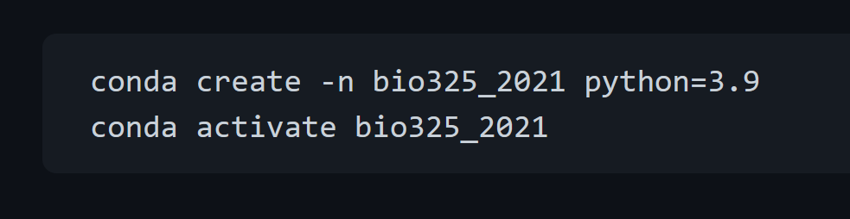
Create a virtual environment for Python
Windows
Linux
macOS

Slide 14
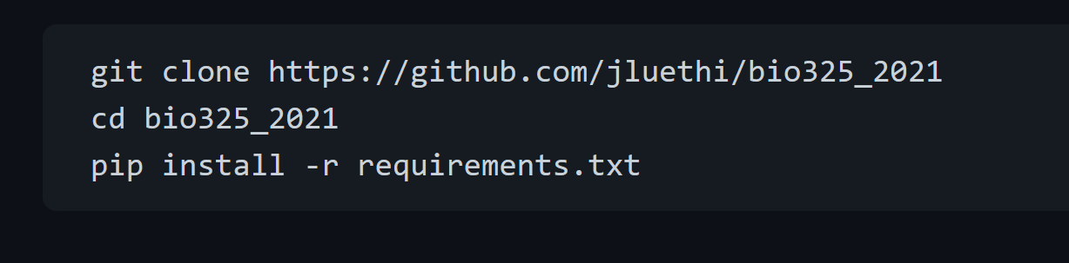
Clone the bio325_2021 github repository and install the requirements

